Slide 1
Introduction to Smart Data Models
FIWARE Foundation
Data Modelling Expert
Alberto Abella

Slide 2
Contents and goals
About:
During this part of the session you will get introduced to the Smart Data Models Program
This session will:
Explain basics about the Smart Data Models program and how it is governed
Introduce you to data models for specific verticals that are already available
Explain how you may contribute extensions to existing data models under Smart Data Models
Explain how you may contribute new data models under Smart Data Models
Goals:
After this session you will be able to implement a service using a Smart Data Model
You will be able to explain how to become an active contributor to the Smart Data Model program
Link to the content

Slide 3
Contents and goals
Question:
What industrial sector are you interested in so we can visit this while the online demonstration (use the chat)
This presentation is available at https://bit.ly/i4trust (Recommended to get the links)
Write it down in this link http://bit.ly/github_users

Slide 4
Agenda
What is the Smart Data Models Program.
Structure and governance
Current Status
Becoming a contributor of Smart Data Models Program
Practical exercises
Services for creating a data model
Creating an official data model

Slide 5
Smart Data Models: Introduction and Governance

Slide 6




Introduction and Governance
Steering Board :
Four members (January-2022)
IUDX: Indian Urban Data Exchange
Public entity supporting data interchange for Smart cities in India
TMForum:
Worldwide Telecommunications association
FIWARE Foundation
Curator of the open source FIWARE platform and its ecosystem
Open and Agile Smart Cities
Smart cities association for the cooperation and mutual learning

Slide 7
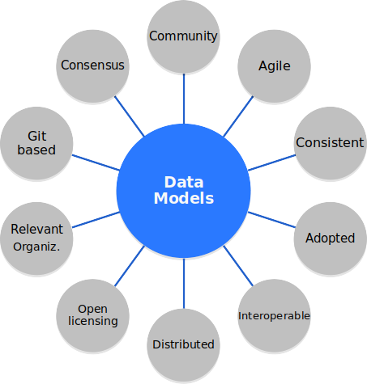
Introduction and Governance
A community site with detailed data models available for open use for multiple sectors
Together with other relevant organizations in the curation of the different domains and subjects
Providing coherence and consistency between data models across different domains
To create a method for AGILE standardization and evolution these data models
To provide extended usefulness to FIWARE platform users in terms of:
Extended interoperability
Reduced time dedicated to data model codying
Accumulated experience tested in real case scenarios
Mapped to be integrated with other platforms
Using open licensing to allow extensive use and adoption
Based on real case scenarios
Based on git platform and github as development frontend
Consensus as main decision method
Based on widely adopted standards (including ontologies and international schemas (i.e. schema.org)

Slide 8

Introduction and Governance
Differential advantages
Agile standardization. Standardization time takes Weeks vs months/years
Easy contribution. One single file source of truth.
Based on actual experience. All data models are based on real case scenarios.
Multilanguage (6). Automation translation of specs.
1 change for all domains. Changing a data model impact on all the domains related to it.
By Pieter Brueghel the Elder - bAGKOdJfvfAhYQ at Google Cultural Institute, zoom level maximum, Public Domain, https://commons.wikimedia.org/w/index.php?curid=22178101

Slide 9

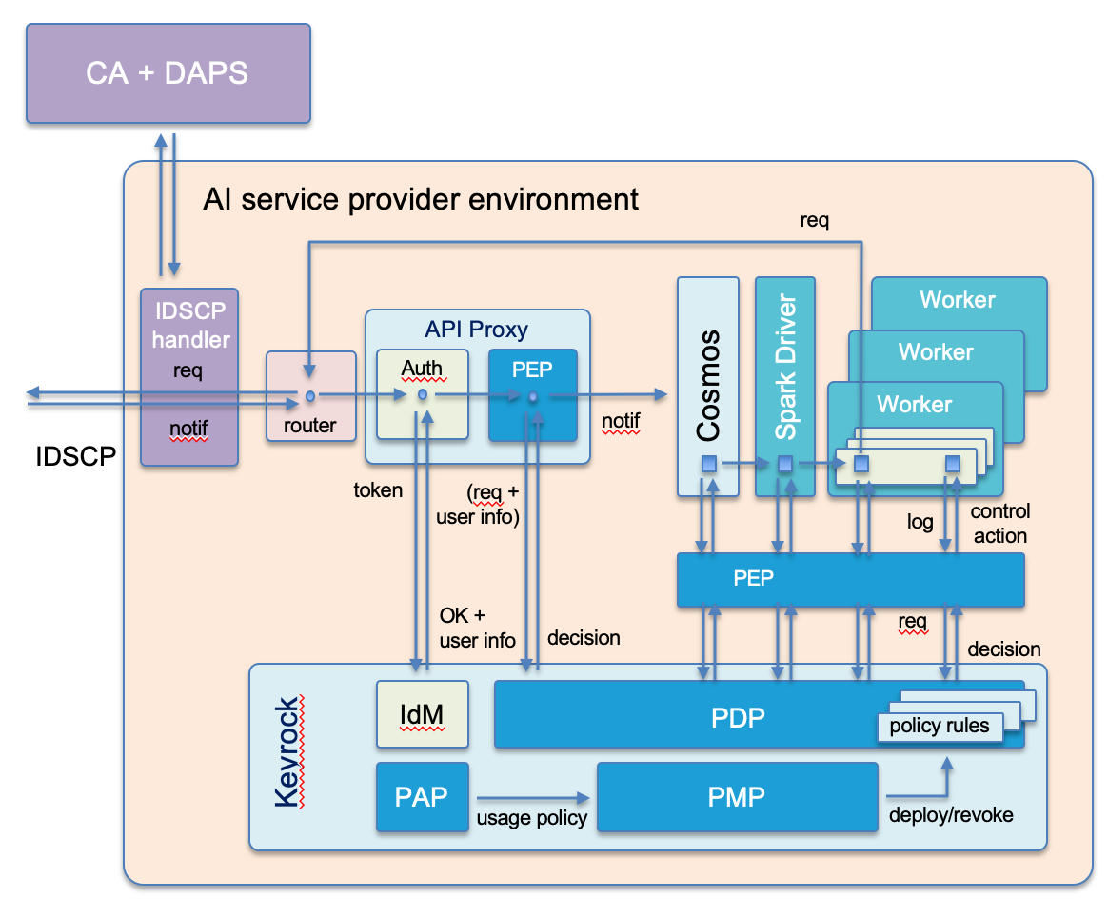
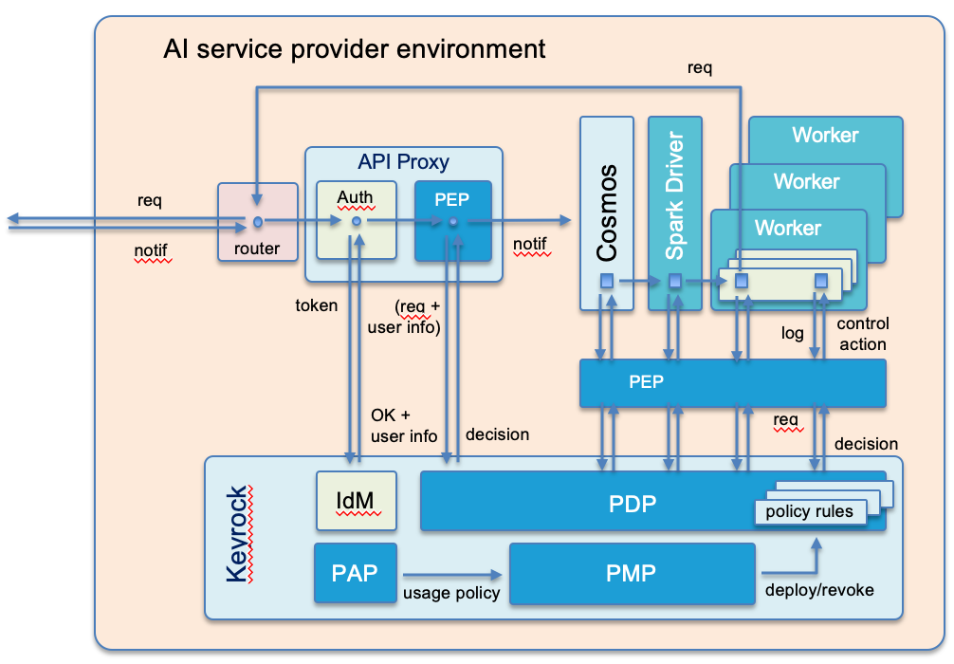
Why should you use Smart Data Models
Don’t reinvent the wheel. Take advantage of the experience of other FIWARE users
Many attributes (>16.000 already available in the database). Don’t create definitions yourself unless you really want to do it.
Specification automatic generated in 6 languages (EN,FR, GE, SP, IT, JA). No work for the creators
Examples of the data model available
Following open and adopted standards
Everything is open-licensed (Free reuse, free modification and free sharing)
It does nos impose restriction on using additional attributes (e.g. internal ones)
It does nos impose restrictions on how many attributes has to implement in your use case
Trusted Spark DT
Basic Spark DT

Slide 10
Smart Data Models: Structure and contents. Verticals

Slide 11
Smart Data Models: Structure and contents. Verticals
What is a Smart Data Model:
It is the combination of 3 elements
A technical description of the data types and relationships of the attributes of an element that has to be modeled
A documented description of these attributes aligned with the technical description
Some examples of the use of the data model
Based on real case scenario (not theory or academic research)
With an open license allowing its use, share and modification
What is NOT a Smart Data Model
It is not an ontology describing the elements of an area of knowledge
A new standard
An academic exercise

Slide 12


Structure and contents. Verticals
DATA-MODELS
Guides for coding new data models
Template for new data models and examples
Directory for scripting tools to check data models
Official list of domains and data models
data-models
Umbrella repo
DOMAINS REPOSITORIES
Readme pointing to the list of subjects
General info or shared resources
Smart Water
Smart Cities
Smart
Environment
Smart
Building
Smart
Destinations
Smart
Energy
Smart
Manufacturing
Smart
Robotics
Smart
Agrifood
SUBJECTS’ REPOSITORIES
Subject 1
(sewage)
Subject 2 (parking)
Subject 3 (weather)
Subject 4 (...)
Readme pointing to the list of data models for the objects
Contributors.md
subject-schema.json
DATA MODELS
README.md
/doc/spec.md
/examples
schema.json
Adopters
LIFECYCLE MANAGEMENT REPOSITORIES
Incubated
Harmonization

Slide 13
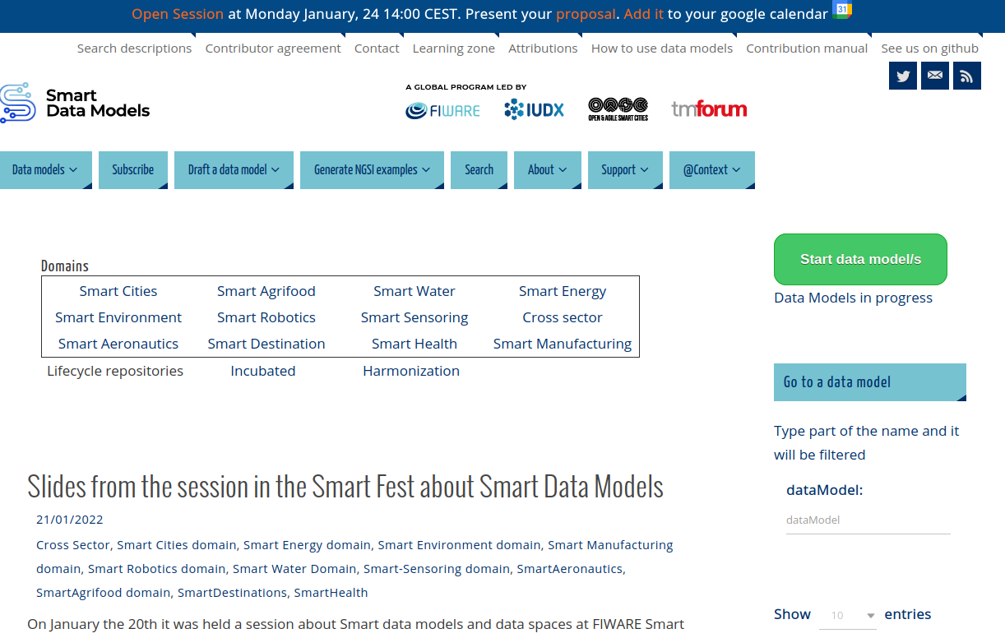
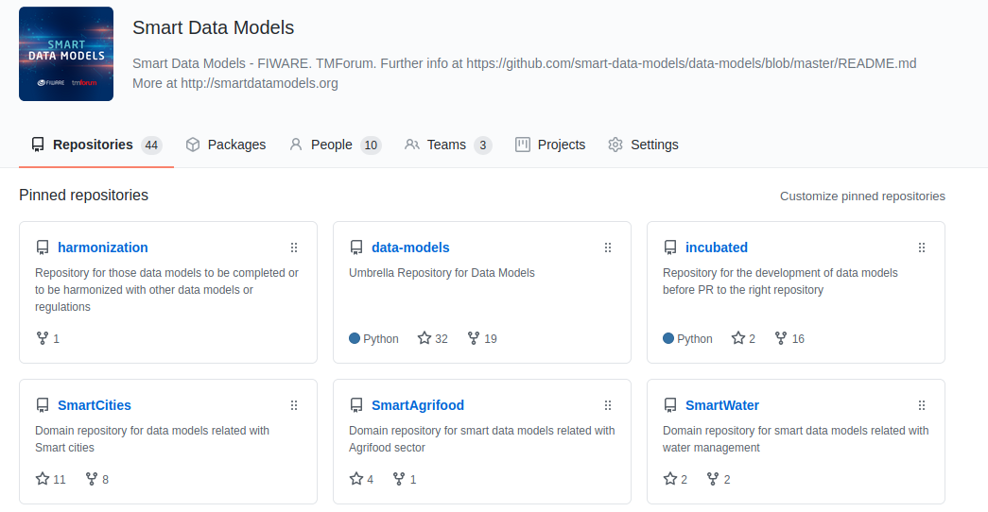
Structure and contents. Verticals
GITHUB
http://github.com/smart-data-models
SITE (wp)
http://smartdatamodels.org
Oriented to developers
All resources available
Contribution by PR
Issues on data models
Demo visit
Oriented to end users
News on updates (subscription)
Check attributes and enumerations
Check descriptions
Demo visit

Slide 14
Current status (domains, subjects & data models)
1
Smart Energy 419
7
Smart Agrifood 20
2
Smart Cities 85
8
Smart Aeronautics 13
3
Smart Sensoring 76
9
Smart Destination 11
4
Cross Sector 66
10
Smart Robotics 6
5
Smart Water 35
11
Smart Manufacturing 3
6
Smart Environment 23
12
Smart Health 2
Updated 24-1-22

Slide 15
Current status: New subjects new data models
717 Official Smart Data Models
88 on the queue to be accepted
53 subjects (Groups of data models)
1
OCF
2
Digital Innovation Hub
3
Unmanned Aerial Vehicle
4
Public Accountability
5
Call Complaints
28 DM Harmonization
75 DM
Incubated
6
DCAT-AP (Open data)
Updated 24-1-22

Slide 16



Contributors and dissemination
111 active contributors
220 contribution in data models
19 services to contributors in data models
Contributors belong to 71 different organizations
Terms available for search 16.525
Documented adopters 88
Every term in data models has an associated page https://smartdatamodels.org/term
Google finds 897 pages in smartdatamodels.org
Updated 24-1-22

Slide 17
Structure and contents. Verticals
Services for users
News, subscription to newsletter, and twitter account @smartdatamodels
Search data models
Repositories of data models, quick list.
Services for developers
Checklist for submitting your new data model
Create your data model with an editor
Create your data model in the incubated repository
Create a examples compliant with a data model (NGSI-LD)
Validate if your data model is well documented
Validate your payload (external)

Slide 18
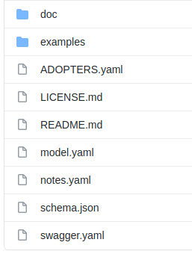
Structure and contents. Verticals
Contents:
schema.json single source of truth of the model. Validates only the key-values payloads
examples : Directory for examples
ADOPTERS.yaml use cases of the data model
doc: directory for specifications
LICENSE.md license of the data model. I.e. CC-BY
README.md pointer to the main elements of the data model, including examples, specifications and other services
model.yaml technical description of the attributes for embedding into the specifications
notes.yaml additional file for customization contents for the specifications
swagger.yaml yaml file required for the interactive specification and future test of services
Mandatory
Optional
Automatic

Slide 19
Smart Data Models: Become a contributor.

Slide 20
Smart Data Models: Become a contributor.
1
Pull request on the incubated repository after completing the contribution checklist
3
Do you have a use case?
No
Exception management
No
Create your proposal of update
Yes
Fix the comments
Is any data model related?
Yes
Pass the manual review?
3
Pull request on the official repository of the data model
Yes
No
Fix the comments
Access contribution manual and draft yor data model (tool) in your repository
Yes
Pass the manual review?
No
Option 1
Publication process
Option 2
(recommended)
Ask permission to contribute in the incubated repository
2
Work on the incubated repository and ask for support through issues or mail
LEGEND
1: Start new model
2: End new model
3: Start update existing model
‹#›

Slide 21
Smart Data Models: Contribution Manual
Available at https://bit.ly/contribution_manual
‹#›

Slide 22
Smart Data Models: Exercises
Turn a data source definition into a data model

Slide 23
Exercise
Expected knowledge from the participants
Knowledge of NGSI-v2 and NGSI-LD and their differences
Some work with a Context Broker (any of them)
JSON and JSON Schema
Git and GitHub concepts
A code editor like PyCharm
‹#›

Slide 24
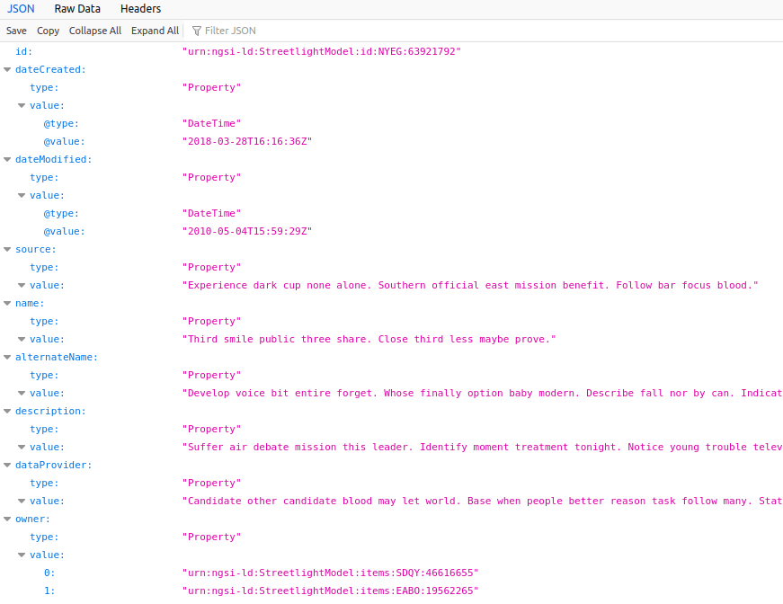
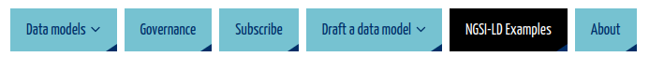
Before we start. Checking services @smartdatamodels
Generate the key-values of payload
Use the script or manually with your code editor
‹#›

Slide 25
Exercise
It is required your github users to be written here (http://bit.ly/github_users) to grant you access to the incubated repository.
If you do not have a github user, then go here: http://bit.ly/register_github
Use the repository incubated. https://github.com/smart-data-models/incubated/tree/master
The final exercise is to submit a complete data model.
Complete the creation of an official data model through all its steps.
It will be done with official sources, so the result of the exercise, if completed, will become an official data model of the program.
Comments to the contribution manual will be incorporated
If not completed during session time It can be completed afterwards
‹#›

Slide 26
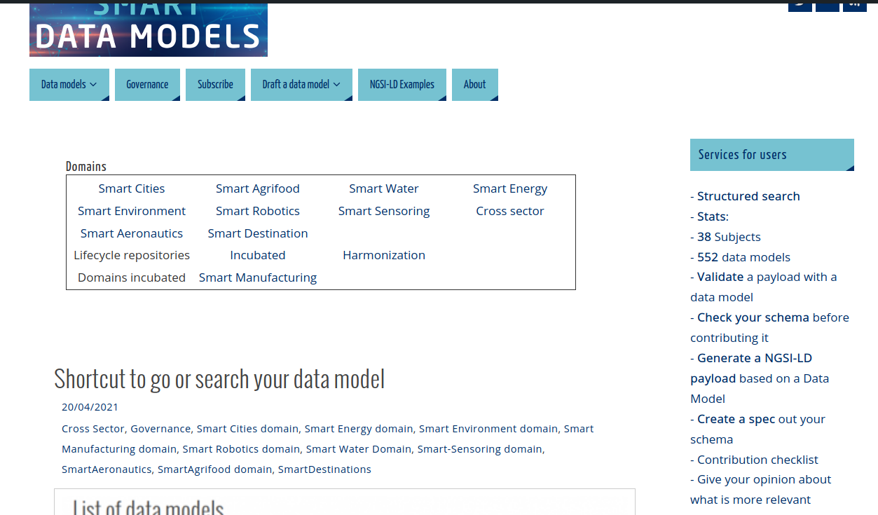
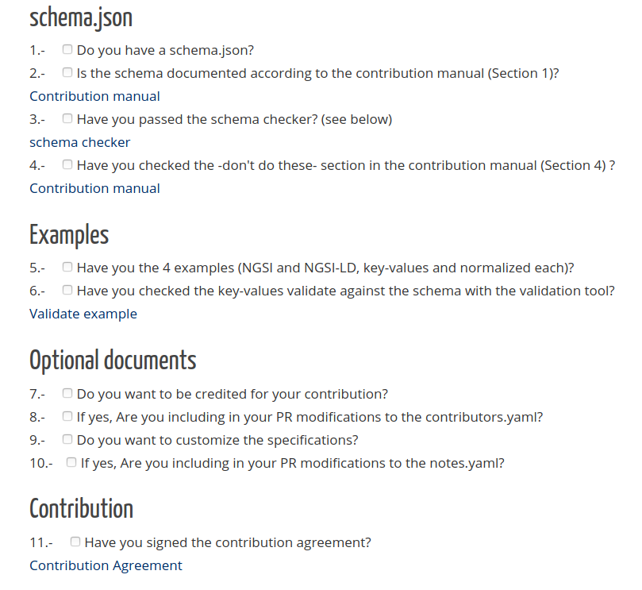
Become a contributor
Checklist for contribution
‹#›

Slide 27
Exercise
Data sources
These data sources have dozens of properties. We’ll only take a few for the exercise.
https://www.schema.org/MedicalCondition
https://www.schema.org/MedicalGuideline
https://www.schema.org/Drug
https://www.schema.org/MedicalScholarlyArticle
https://www.schema.org/LocalBusiness
https://www.schema.org/Organization
https://www.schema.org/Restaurant
Other available. https://www.schema.org/docs/health-lifesci.home.html
Take a minimum of 5 properties, one an object / array.
‹#›

Slide 28
Exercise
Data sources
Other data sources could be valid as well as:
It has documented attributes
It has clear data types for the attributes
It is on use in some real case scenario
‹#›

Slide 29
Exercise
Steps:
Access to the data source
Open the editor
Paste the data definitions in the editor according to the instructions.
Generate the json schema
Validate the json schema
Generate the example of payload
Validate the example against the schema
Submit the new data model
‹#›

Slide 30
Exercise
Review the contribution manual
Contribution manual is linked in the main page or in https://bit.ly/contribution_manual
‹#›

Slide 31
Exercise
Access to the data source. Examples available.
https://www.schema.org/MedicalCondition
https://www.schema.org/MedicalGuideline
https://www.schema.org/Drug
https://www.schema.org/MedicalScholarlyArticle
https://www.schema.org/LocalBusiness
https://www.schema.org/Organization
https://www.schema.org/Restaurant
https://www.schema.org/docs/health-lifesci.home.html
‹#›

Slide 32
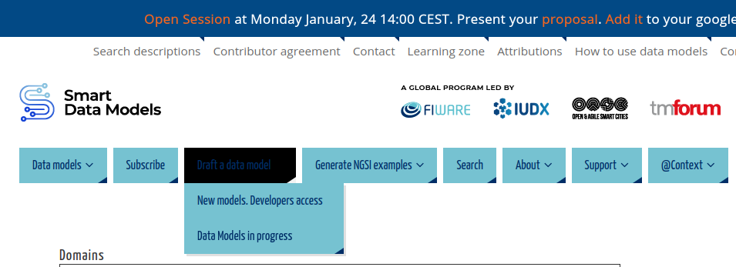
Exercise
Open the online editor
‹#›

Slide 33
Exercise
Paste the data definitions in the notepad according to the contribution manual.
We’ll see this in these 3 videos (9 minutes). Learning zone at smartdatamodels.org
‹#›

Slide 34
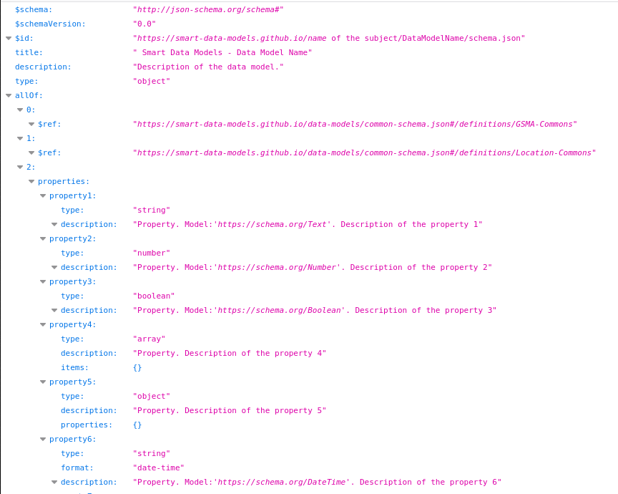
Exercise
Generate the json schema
Fix possible errors
Provide more detail / limits
Include Units
Include Enumerations
Include Privacy
Include limitations to values
Required Properties
‹#›

Slide 35
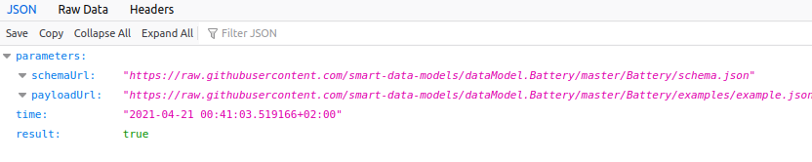
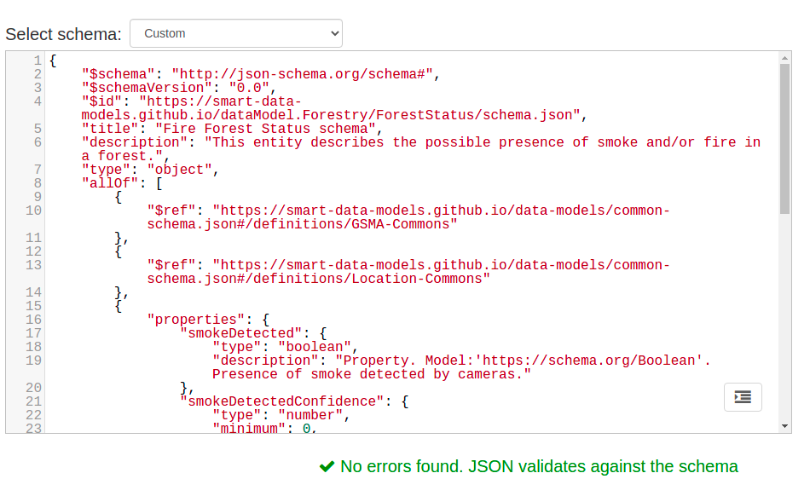
Exercise
Validate the json schema
Validation of the json schema https://www.jsonschemavalidator.net/
Validation of the documentation https://smartdatamodels.org/index.php/data-models-contribution-api/
‹#›

Slide 36
Exercise
Generate the normalized example of payload
I.e. NGSI-LD is available
Needs edit for meaningful data
‹#›

Slide 37
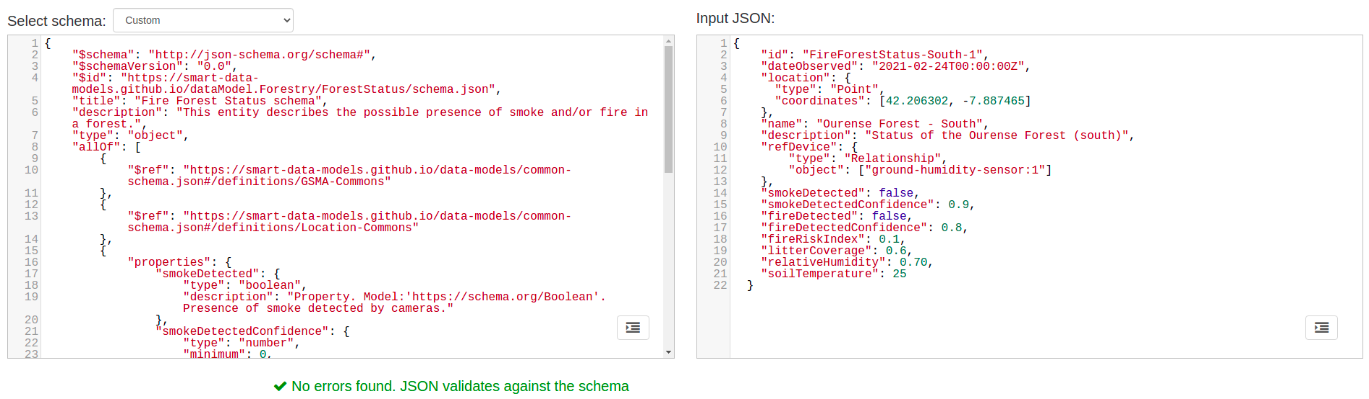
Exercise
Validate the payload (keyvalues). https://www.jsonschemavalidator.net/
‹#›

Slide 38
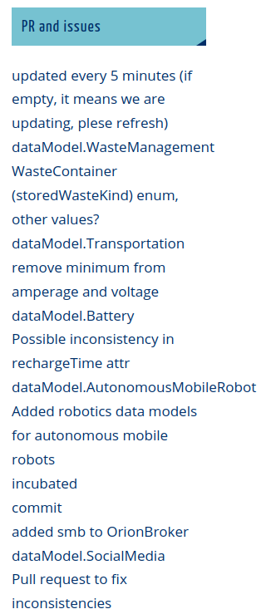
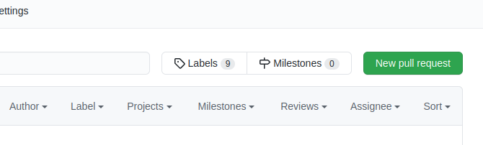
Exercise
Fork the incubated repository
PR your changes to the data model
They will appear in the front page in 5 minutes maximum (right column, bottom)
‹#›

Slide 39
Smart Data Models: Summary

Slide 40
Summary
Goal
Allow real interoperability between NGSI data sources
Contribution:
Always possible as long as it has a use case, and comply with contribution workflow
Use of the data models
Search tools for finding the right data model
Best not to reinvent the wheel
Differential advantages of agile standardization
Quick answer
Do not invent
Easy contribution
Single source of truth
Better simple and useful than technically ‘correct’ and powerful

